Slide 1

higher Design & Manufacture
The Design Process

Slide 2


Learning intentions & success criteria
Learning Intentions
Develop an understanding of the design process.
Success Criteria
I can organise the stages of the design process in chronological order.
I can explain what is involved in each of the design process stages.

Slide 3



The design process
There are many models that can be used to describe the design process.
The design process is a series of stages that the design team go through to take a product from the initial concept to the final proposal.
The following slides will look at each of the stages individually and explain what is involved.
You will be expected to follow these stages in your own projects and assignments in class. Therefore, ensure that you remember the order correctly and are familiar with what is involved.

Slide 4

Design brief
The design brief is the overall idea for the product.
The brief may be asked of the design team by a client, to design a specific item.
The brief may also arise from identifying a new need, therefore a new product.
It may also be created to solve an existing problem or to improve upon an existing product.
Essentially, the brief is what the product needs to do.

Slide 5

research
Before you begin sketching ideas for a product, you should do plenty of research.
You can conduct research by using books, magazines, going online, to see what existing products look like, what materials they are made from and why.
You may also want to identify your target market (who you are selling the product to), and find out what they want from the product. You can do this by creating surveys and questionnaires that ask specific questions to help you get started with the design.

Slide 6
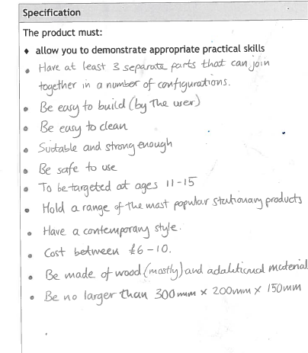
Product specification
A product specification is a list of requirements that the product must fulfil.
This list will likely come from a mixture of the brief (what the client has asked for) and your research (what the target market needs and wants).
In creating this list, you have a starting point from which you can go on to begin sketching your first ideas.

Slide 7
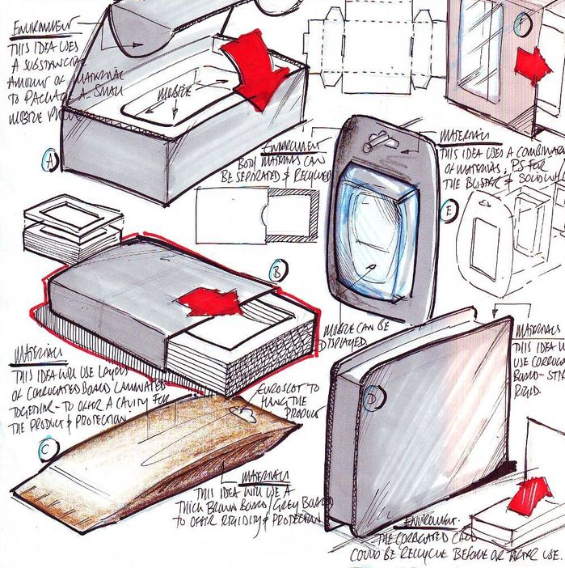
Initial ideas
To begin with, after your research and specification list is created, you will be asked to come up with around 6 different initial ideas for your design.
These are the first ideas that come into your head for the overall look and shape of the product.
These should be very sketchy, but are annotated (labelled with notes) to explain what the product does, what it is made from, how it functions (moves, goes together etc).

Slide 8
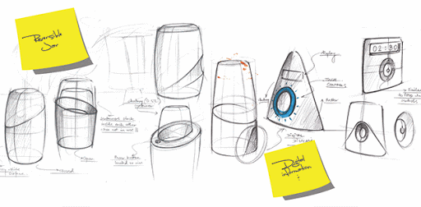
Idea analysis
You will be asked to look at all of your initial ideas and compare them against the product specification list.
You will generate a scoring system, which enable you to decide which of the ideas to go on to develop, as it will score the highest.

Slide 9
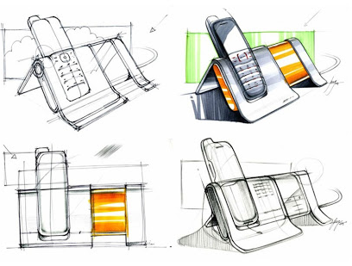
Design development
Once you have around 6 different initial ideas on paper (or you may have modelled them too), you will be asked to develop 1-2 of these ideas.
By developing the ideas, you are required to go into more detail about how it looks, works and goes together.
You will be required to look at the different design factors (explained in a later presentation), which will help you turn your initial idea into a better idea.
You may also find that borrowing some of the other initial ideas and incorporating them into the final design, may be beneficial.

Slide 10
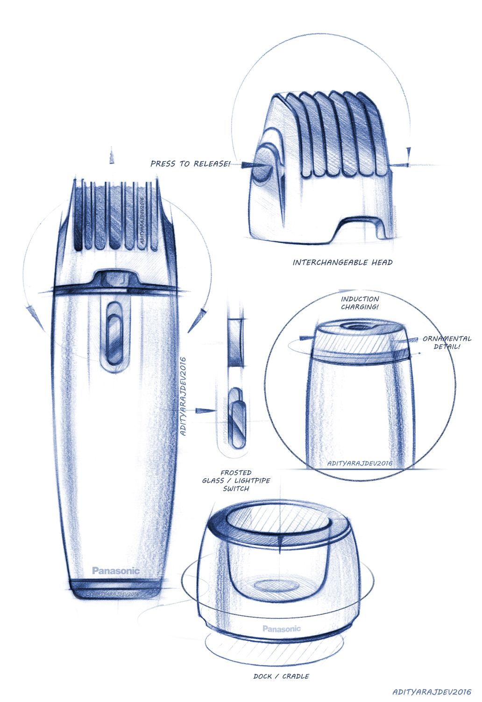
Final idea
The final idea is the end product. After you have developed one of your initial ideas using the various design factors, you should have a finished idea.
You will be asked to present this in the form of 2D sketches, 3D sketches, card/cardboard models or computer models.
You will now have a very good idea of how the product: looks, works, assembled together, what materials it is made from and what manufacturing processes it would require to be made.

Slide 11
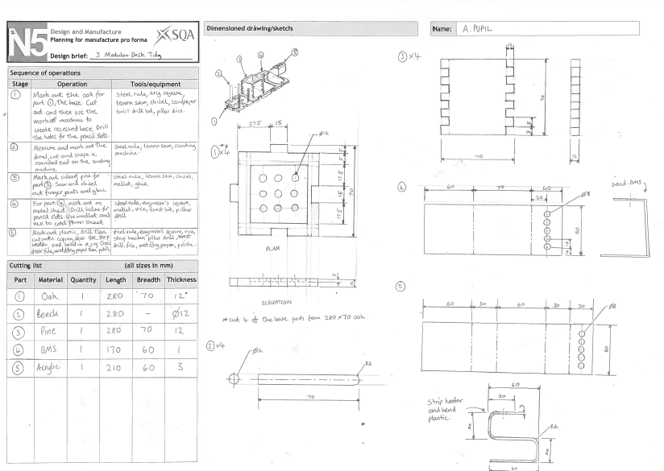
Plan for manufacture
The plan for manufacture is essentially a step by step guide as to how your product would be made.
You must know the different tools and processes used in each stage of marking out, cutting, filing, sawing and finishing each material.
You will also be required to produce a cutting list, which is a list of each material to the exact size you require, before you begin to mark and cut the design out from it.

Slide 12
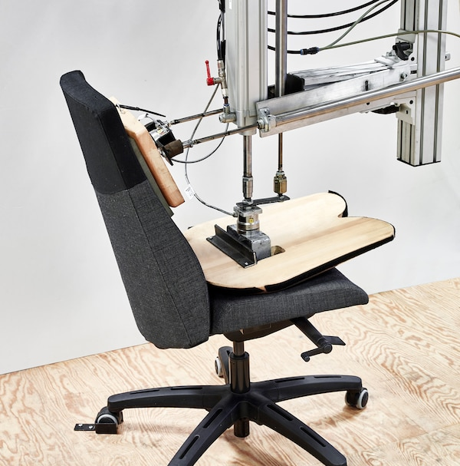
testing
The final prototype, once manufactured, should be tested.
Many companies e.g. IKEA, test their products using machines, for example, a machine which simulated someone sitting on a chair over and over.
It is vital that products are tested before they are then manufactured on a larger scale, to ensure they are both safe and function as desired.
If the products fail the tests, then the design team must go back to developing the product again to ensure they fix any issues.

Slide 13

evaluation
A product evaluation is essentially asking if the final design and prototypes meet the design specification.
Does the product do what it is meant to do?
Does it do it well?
Is the client happy with the final product and meets their expectations?

Slide 14

Complete process
The following is the comprehensive list of the design process. Some additional steps in between those mentioned, are listed below:
  Identification of Needs and Wants
  Market Research
  Initial Design Brief
  Design Brief Analysis
  Research and Investigation
  Design Specification
  Initial Idea Generation
  Design Development (drawings, models)
  Analysis of Ideas
  Presentation of Idea
  Evaluations, Discussions and Negotiations
  Synthesis of Ideas
  Design Proposal
  Planning for Manufacture
  Working Prototype
  Testing and Evaluation

